Slide 1
Team 20 - Automated Annotation of Source Code for ML Applications
S E 491
December 2022

Slide 2
Team
Robby Rice - Digital Content Coordinator
Maxwell Sutcliffe - Client Communicator Coordinator
Tanner Dunn - Agile Framework Organizer
Gavin Canfield - Quality Control
Amon McAllister - Individual Component Design
Arushi Sharma - Client
Professor Ali Jannesari - Faculty Advisor

Slide 3
Presentation Contents
Project Context
Users, Needs, and Problem Statement
Requirements
Conceptual Design
Detailed Design
Analysis, Prototypes, or Implementations
Design Complexity
Project Plan
Risks/ Challenges
Test Plan
Conclusions
Appendix

Slide 4
What is this project?
Project Context

Slide 5
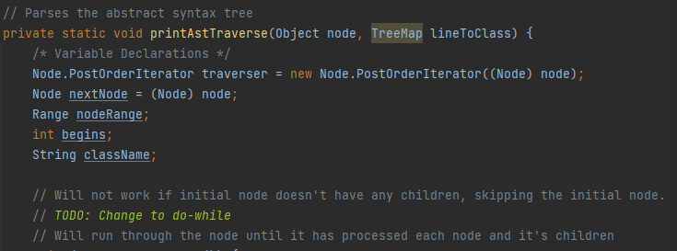
Automated Annotation...
"Automated" implies no manual work
"Annotation"?
Source code contains "labels"
Low level: keywords
High level:
Declarations, block statements, if statements, etc.

Slide 6
… for Machine Learning Applications
Create a dataset of label source code
Intended for use in machine learning
Arushi's goal:
Uncover the "black box" in AI for code tools
Research links that unsupervised machine learning finds

Slide 7
Why are we solving this problem?
Users, Needs, and Problem Statement

Slide 8
Users and Their Needs
Enthusiasts
Amateurs
Documentation, and ease of use
Implementation into their own projects
Arushi Sharma
PhD research
Better utilize machine learning
Push machine learning to new depths
Machine learning engineers
Professionals
Documentation, training, and results

Slide 9
Problem Statement
Source code contains many different types of “tags” or words that belong to groups that perform certain functions. With the assistance of machine learning and natural language processing, we hope to create an algorithm that will correctly predict what “tag” any one word in source code belongs to, then, with the help of machine learning, provide a quick comment on what the code is doing.
There is a small suite of tools available already, but our client (and PhD advisor) wants to expand these tools. These tools are trained by neural networks that are essentially a “black box” and don’t reveal the connections they make to the engineer. The point of the PhD’s research is to uncover these relationships and see if they are predictable.

Slide 10
What is expected from this project?
Requirements

Slide 11
Functional
resource
Annotation of source code
Correctly chunk and label code
Sufficient hardware to train model
user experience
User interface
Labeled code in clear way
Documentation required to run and edit the scripts
There are no requirements concerning aesthetic, economic or the environment.

Slide 12
What might the project internals look like?
Conceptual Design Overview

Slide 13
Conceptual Design

Slide 14
Design Decisions
Language, are project is centered around source code
Chunking and labels, the next step was breaking up source code
Data formatting
ML pipeline
Requirements impact
Our requirements were predominantly functional, giving us much leeway for nonfunctional requirements.

Slide 15
How will we implement our design?
Detailed Design

Slide 16
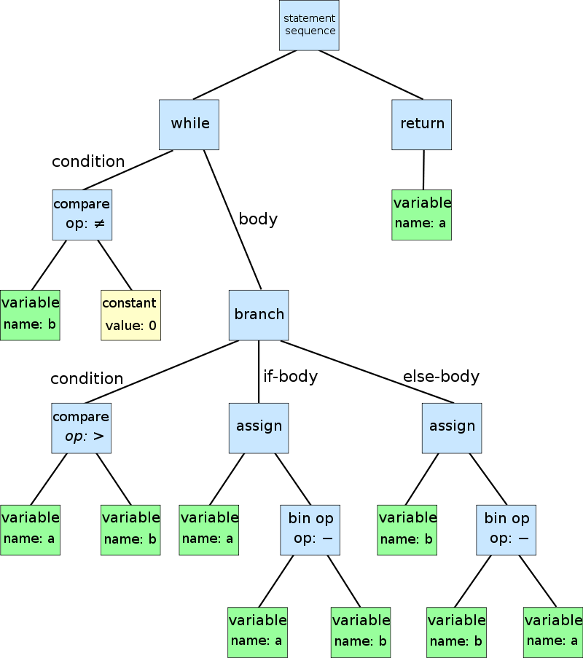
Abstract Syntax Tree
Parse source code
Convert into tree representation
Code is broken up into nodes
Nodes contain valuable information
Node class
Child / parent nodes
Line in code
Code snippet

Slide 17
JSON Preprocessing
Create dataset formatted as a JSON object
Separate the tokens and the labels in different properties
Store other relevant data

Slide 18
Machine Learning
Data Columns (Code Snippet, Label)
Split the data into training and testing
Train Models (Logistic Regression, Decision Tree, Random Forest)
Compare Accuracy

Slide 19
What progress has been made thus far?
Analysis, Prototypes, Implementations

Slide 20
Implementations
1st iteration : jflex
2nd iteration : antlr
3rd iteration : Javaparser
Regex proved to be difficult and time consuming
Did not do enough
Went beyond what was trying to be done
Back tracking proved to be to be difficult and time consuming
Did too much
Worked well
Simple
Many additional tools for analysis
Built in abstract syntax tree

Slide 21
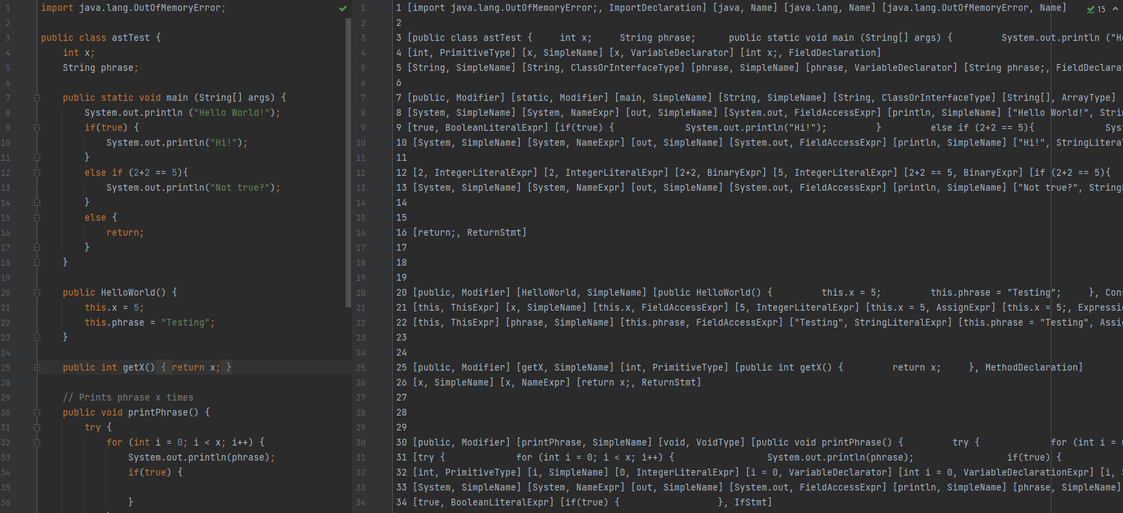

Slide 22
What have been some challenges?
Design Complexity

Slide 23
Design Complexity
Chunk and labeling code
Machine learning
Numerous ways to label code
Numerous ways to write code
Numerous edge cases
Numerous online parses that can help (Jflex, Antlr, and JavaParser)
Numerous algorithms
Numerous factors to consider
Reiterations between the label creation and the machine learning aspect

Slide 24
What are some techniques and ideas we used to plan?
Project Plan

Slide 25
Schedule
Todo: Update

Slide 26
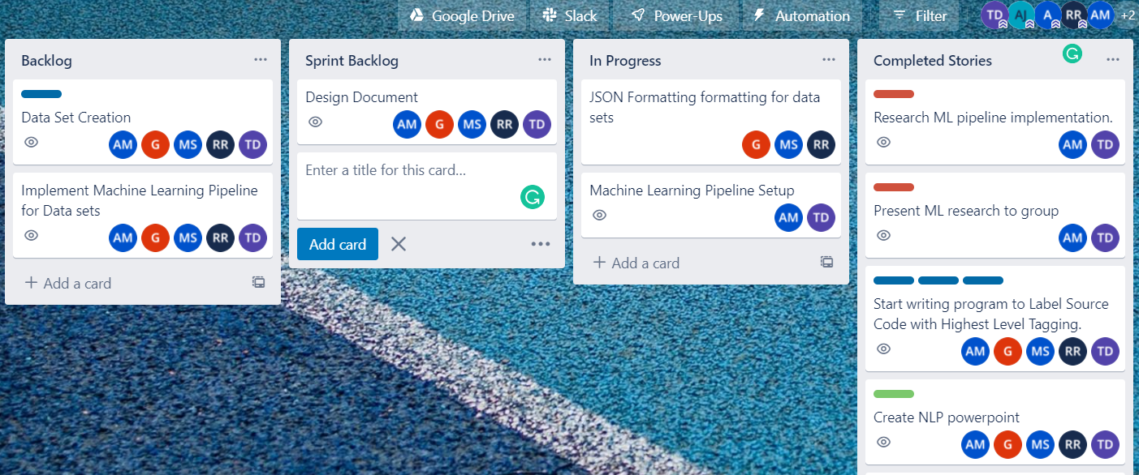
Planning Strategies
Agile Methodology
Weekly Sprint Planning/Review with Stakeholder

Slide 27
Problems? How did we solve them?
Risks/challenges

Slide 28
Risks & Challenges
Tool is inaccurate (0.8)
ML pipeline is bias, research inaccurate
Final Decisions – Committing to use of Tools
No prior ML knowledge (mostly)
Dynamic project – scheduling difficult
Very loose requirements
Full risks table: Index 5

Slide 29
How are we testing?
Test Plan

Slide 30
Testing Plan
Twofold:
Labeling tool:
Test for human error
Traditional testing
Machine Learning:
Test multiple algorithms
Check for correctness

Slide 31
Units and Interfaces
Units (individual components):
User Input
Abstract Syntax Tree Creation
AST Classname Gatherer
Label File Creation
Interfaces (combined components):
AST Internals
User Interactions
Detailed Unit Tests table: Index 2

Slide 32
Acceptance Testing
The most important
Label files must be correct
Incorrectness can lead to incorrect machine learning conclusions
"Accuracy" in our case is not missing a feature in the code
Current setup won't create new features if they're not there

Slide 33
Thank you!
Any questions?

Slide 34
Index 1
Diagram of label-maker internals.

Slide 35
Index 2
Name | Description | Test Plan
User Input | Grabs user input file and asks for parameters for label file creation. | Give sample input and ensure file location exists and writes correct file output. Edge cases include empty strings and illegal characters that would interfere with label file creation.
Abstract Syntax Tree Creation | Creates an abstract syntax tree from source code. | Out of our control as we use a tool called JavaParser for this, however, we can test it with edge cases (empty .java files).
AST Classname Gatherer | Given an AST, we traverse through the AST nodes and collect the line number and type of feature. | Create Java files that do not follow convention but can technically compile. Test parameters (low vs high level classnames) are being correctly sorted.
Label File Creation | Given a classname TreeMap, print keys and values to label file. | Test what happens when label file cannot be created, or dictionary is empty. Edge case testing.
Detailed test plan

Slide 36
Index 3
Label example

Slide 37
Index 4
TreeMap data structure

Slide 38
Index 5
Task | Risks | Mitigation Efforts
Decide on Tags | N/A, largely a research task | N/A
Manual Dataset Creation | Incorrect Tagging, 0.2 | N/A
Create RegEx Tool | RegEx not possible for a certain tag, 0.4 Tool is inaccurate, 0.6 | We have multiple ways for creating datasets (line by line vs word by word) which can help with RegEx limitations. With an inaccurate tool, this will delay the schedule. Time constraints aren’t too dangerous as semester 2 is mostly stretch goals.
Dataset Creation | Cannot find enough source code, 0.3 | Create our own source code
Open-Source Dataset Tool | Tool not ready by Gantt chart deadline 0.2 | Time limitations aren’t crucial to deliverables
Dataset Refinement | Dataset doesn’t fit into model, 0.7 | Significant time setback. Readjust Gantt chart and reevaluate sprint deadlines.
ML Models Comparison | N/A | N/A
Implementation | N/A | N/A
Documentation | Documentation is lost, 0.1 | Store digitally and rewrite.
Full risks table

Slide 39
Future Plans
Possible refactor of AST Creation
Dataset creation (~200 .java source code files)
Machine Learning

